Slide 1
Disruptive
Technologies-I
Submitted to:- Dr. Shonak Bansal (E10103)
Topic- Email Spam Classifier Using Python and Machine Learning

Slide 2
Certificate
This is to certify that Ayush Prem (23BCS10452), Pranjal Verma (23BCS11470), Priyanka (23BCS10834), Asha Ravesh (23BCS10657) and Sejal Wadhwa (23BCS10668) of class and section 206-A has successfully completed the project work on Disruptive Technologies-I for 1st Semester under my supervision on topic "Email Spam Classifier Using Python and Machine Learning".
They have demonstrated exceptional skills throughout the project. They have shown a deep understanding of the subject matter and have applied their knowledge to develop a creative and innovative solution.
Certified By:-
Dr. Shonak Bansal (E10103)
(Subject Teacher)

Slide 3
Acknowledgement
I would like to convey my heartfelt gratitude to Dr. Shonak Bansal for his tremendous support and assistance in the completion of our project. I would also like to thank our Head of Department, Dr. Gaurav Bathla, for providing us with this wonderful opportunity to work on a project with the topic "Email Spam Classifier Using Python and Machine Learning". The completion of the project would not have been possible without their help and insights.
Submitted by:-
Ayush Prem (23BCS10452)
Pranjal Verma (23BCS11470)
Priyanka (23BCS10834)
Asha Ravesh (23BCS10657)
Sejal Wadhwa (23BCS10668)

Slide 4
Introduction
In our digital age, emails are essential for communication and collaboration. They allow us to stay connected with friends, family, colleagues, and clients across the globe. Emails are also used to share important information, documents, and files.
While emails are incredibly useful, spam emails can be a major hindrance. Spam emails are unsolicited and unwanted emails, often sent in bulk for commercial purposes. They can also be dangerous, containing links to malware or phishing attacks.
Spam emails can waste our time, clog our inboxes, and even put our security at risk. That's why it's important to use an email spam classifier to filter out spam emails before they reach your inbox.

Slide 5
What is spam email and ham email?
What is Spam email?
Spam email is unsolicited and unwanted email, often sent in bulk for commercial purposes. It can also be dangerous, containing links to malware or phishing attacks.
Spam emails are typically sent by bots, which are computer programs that can automatically generate and send emails. Bots can be used to send millions of spam emails in a single day.
What is Ham email?
Ham email is email that is not spam. It can be anything from personal messages from friends and family members to work-related emails from work colleagues, banks or government to newsletters.

Slide 6
Key features of Spam mail predictor
The key features of a spam email classifier are its ability to provide insights, enhance its security using machine learning, and ensure our protection against spam emails, phishing attacks, and other digital threats.
Insights: A spam email classifier can provide insights into the types of spam emails that are being targeted at us, as well as the sources of those emails. This information can be used to improve the effectiveness of the classifier and to develop new strategies for combating spam.
Machine learning: Spam email classifiers are increasingly using machine learning to improve their accuracy and robustness. Machine learning algorithms can be trained to identify spam emails based on a variety of factors, including the content of the email, the sender's email address, and the recipient's email address.
Protection: Spam email classifiers can protect us from a variety of digital threats, including spam emails, phishing attacks, malware, and ransomware. By filtering out spam emails and other malicious messages, spam email classifiers can help to keep our inboxes clean and our devices safe.

Slide 7
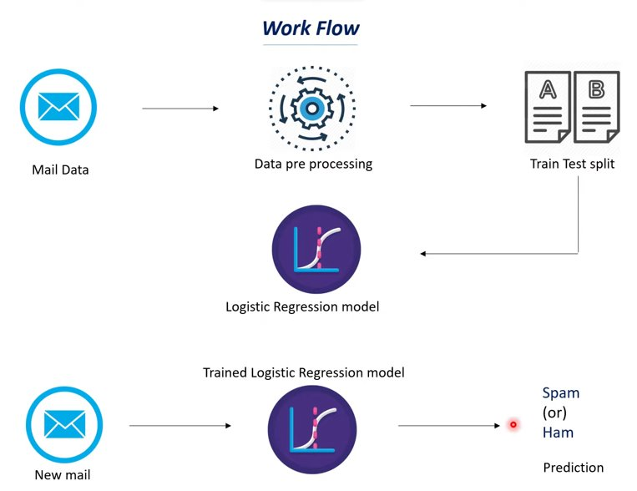
Workflow of email spam classifier

Slide 8
Benefits of Machine Learning in Spam Detection
Machine learning offers a transformative approach to spam detection, surpassing traditional rule-based systems in accuracy, adaptability, and overall effectiveness.
Enhanced Accuracy: Machine learning algorithms analyze vast datasets to identify nuanced patterns, significantly improving accuracy and minimizing false positives/negatives.
Adaptive Learning: Continuous learning from new data enables machine learning to adapt to evolving spam tactics, proactively identifying and mitigating novel spam techniques.
Contextual Understanding: Machine learning analyzes not only email content but also contextual cues, enabling nuanced detection of subtle spam patterns.
Reduced False Positives/Negatives: Dynamically adjusted decision boundaries based on learned characteristics mitigate false positives and false negatives, enhancing user trust.

Slide 9
Benefits of Machine Learning in Spam Detection contd...
Continuous Learning and Adaptation: Machine learning dynamically adjusts its models to the ever-changing nature of spam campaigns, ensuring ongoing robustness and effectiveness.
Scalability and Efficient Resource Utilization: Machine learning efficiently processes large datasets, enabling seamless adaptation to the growing influx of emails.
Personalized and User-Centric Approaches: Machine learning tailors its detection mechanisms to each user's unique patterns, reducing false positives and enhancing the user experience.
Reduced Operational Overhead: Machine learning's self-learning nature minimizes the need for continuous manual adjustments, reducing operational overhead and allowing for more efficient resource allocation.
Futureproofing Against Evolving Tactics: Machine learning's ability to analyze and adapt to emerging patterns future-proofs spam detection systems against evolving tactics.

Slide 10

Software used
Google colaboratory
Google Colaboratory, or Colab, is an as-a-service version of Jupyter Notebook that enables you to write and execute Python code through your browser. Jupyter Notebook is a free, open-source creation from the Jupyter Project.
File link:-
https://colab.research.google.com/drive/11IQ_0MgmM0JY8COKeap1XGB9AQGQw3oo#scrollTo=3Fj8pYkvm0TN

Slide 11
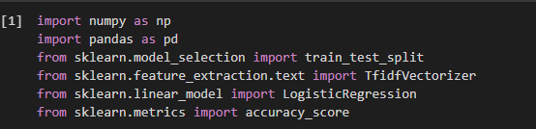
Libraries used
Numpy
Pandas
Scikit-learn

Slide 12
Uses of each libraries
Numpy is used to create Numpy arrays
Pandas is used to create dataframes
Scikit-learn is an open-source Python library that implements a range of machine learning, pre-processing, cross-validation, and visualization algorithms using a unified interface.
from sklearn.model_selection import train_test_split is used to split our data into training and testing data
from sklearn.feature_extraction.text import TfidfVectorizer is used to convert text (mail) data into numerical value so that our model can understand it
from sklearn.linear_model import LogisticRegression to build logistic regression
from sklearn.metrics import accuracy_score is used to find out model good our model is making predictions.

Slide 13
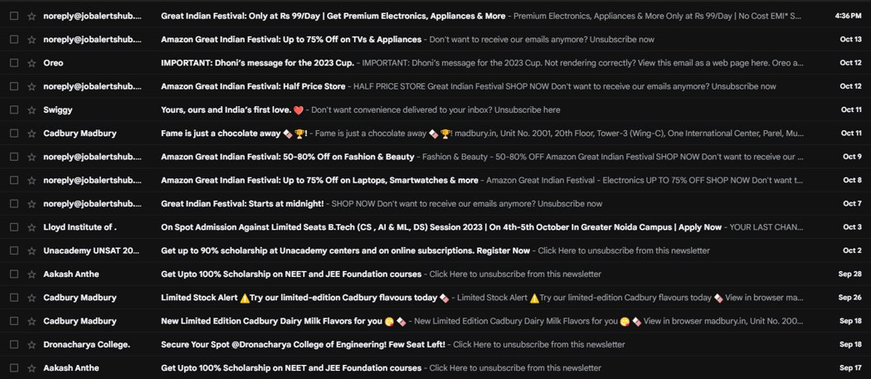
How spam emails looks in Gmail

Slide 14
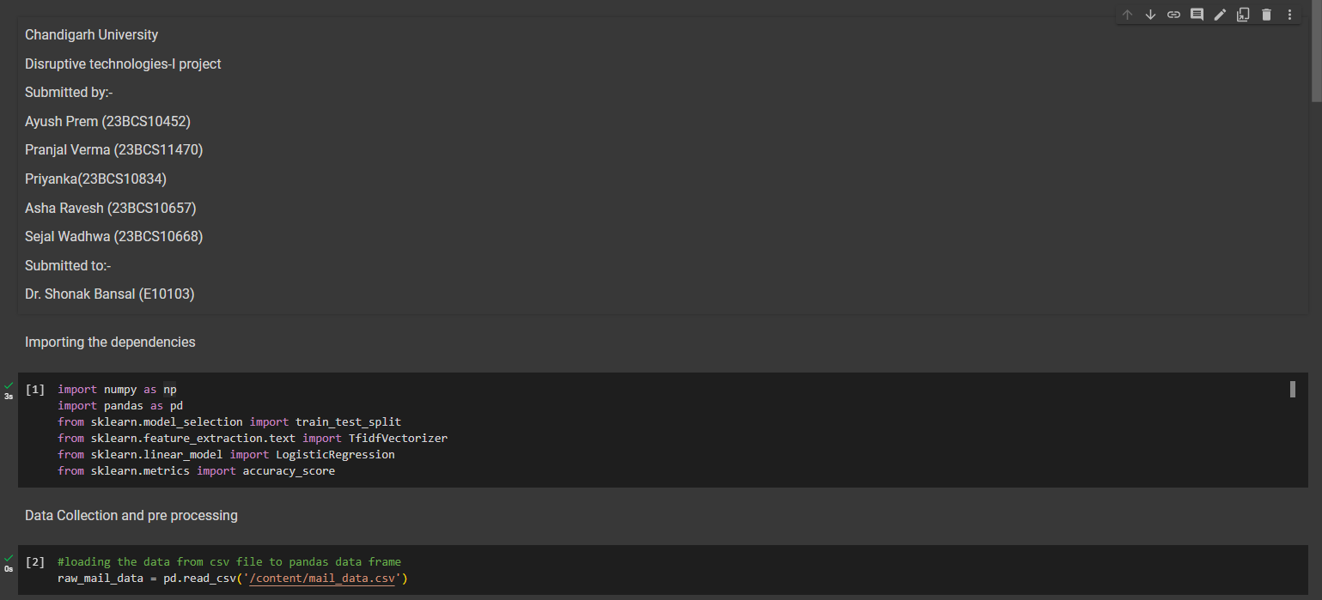
Few Snapshots

Slide 15
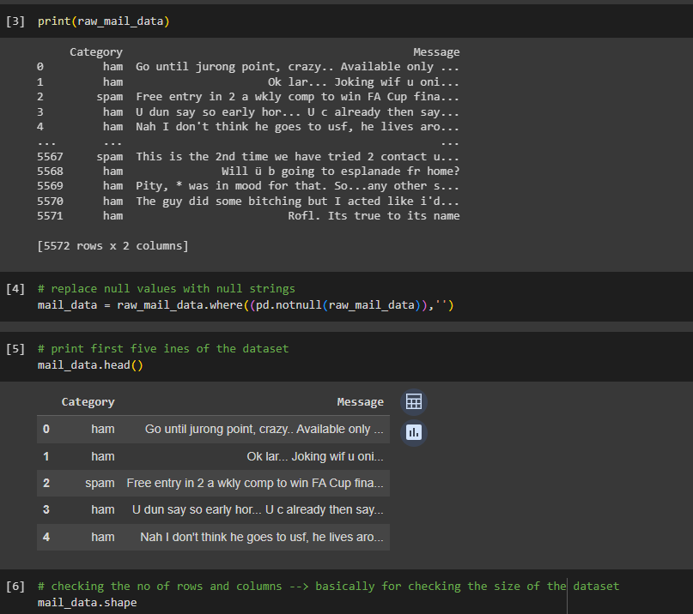

Slide 16
Results
Machine learning-based spam detection has proven to be a more effective and adaptable approach compared to traditional rule-based systems. It offers improved accuracy, precision, and robustness while demonstrating real-world applicability.
Machine learning algorithms excel in identifying spam emails with greater accuracy and precision.
The proposed system exhibits resilience against adversarial attacks and maintains performance under challenging conditions.
Real-world deployment scenarios validate the system's scalability, resource efficiency, and low-latency processing.
Machine learning-based spam detection outperforms rule-based systems in terms of adaptability, scalability, and accuracy.
User-centric adaptation through feedback mechanisms ensures personalized and effective spam filtering.
Ethical considerations and privacy compliance are prioritized to safeguard user trust and data protection.

Slide 17
Implications and Future Directions
Industry Adoption and Integration: The robustness, accuracy, and practicality demonstrated by our machine learning-based spam detection system position it as a viable option for organizations seeking advanced and adaptive email security solutions.
Further Refinement and Model Updates: Future research can focus on continuous model updates, leveraging ongoing insights from user feedback, real-world performance data, and emerging spam tactics.
Collaboration with Email Service Providers: Collaborative efforts with email service providers can facilitate the seamless integration of our spam detection system into widely-used email platforms. Such collaborations can enhance the accessibility and reach of our machine learning-based solution.
Exploring Advanced Machine Learning Techniques: As machine learning continues to evolve, exploring advanced techniques, such as deep learning architectures and ensemble methods, holds promise for further improving the sophistication and effectiveness of spam detection models.

Slide 18
Conclusion Summary
In conclusion, our research not only advances the field of spam detection but also provides a practical and user-centric solution for organizations and individuals seeking robust email security. The successful outcomes, key findings, and contributions presented in this section pave the way for continued advancements in machine learning-driven email security. The subsequent pages will delve into a more granular analysis of specific findings, discuss the limitations of the research, and outline potential avenues for further exploration in the realm of machine learning-based spam detection.

Slide 19
Thank You
Submitted by:-
Ayush Prem (23BCS10452)
Pranjal Verma (23BCS11470)
Priyanka (23BCS10834)
Asha Ravesh (23BCS10657)
Sejal Wadhwa (23BCS10668)

